Slide 1
DISTRIBUTION OF SUPPORT PRODUCTS TO PERSONS WITH ALBINISM IN KENYA
Presented by:
1. Glendah Moraa
2. Ian Gathumbi
3. Caleb Muinde
4. James Muguro
5. Naman Hirani

Slide 2
Introduction
Albinism is a rare skin condition where there is little or no production of melanin that results in one’s skin, hair or eyes to have little or no color. It is caused by a genetic disorder in one of several genes that produce or distribute melanin.
Medical research in 2017 found some types of cutaneous malignancies are common suggesting a lack of access to sunscreen and protective clothing. To try to remedy this, the National Albinism Sunscreen Support Program (NASSP) was set up to procure and distribute sunscreen lotions for persons with Albinism.

Slide 3
Problem statement
The government has put across measures to improve the health standards of persons with albinism following the recommendation stated in a report from a research conducted in the year 2017. As by the report, it was clearly stated that there was lack of access to healthcare, more particularly medical checkups and appropriate sunscreen to persons with albinism.
It is vital for the government to ensure equal distribution of the support products and also to include measures to ensure that the sunscreen provided is appropriate. Therefore, this project aims at drawing insights that will be used to optimize the distribution of sunscreen and support products to persons with albinism over the counties and countrywide.

Slide 4
Research Objectives
General objective
Analyzing the distribution of sunscreen and support products to persons with albinism in all counties in the country
Specific objectives
To determine the total and average distribution for products
To establish whether the county with the highest number of PWA is the one that received the highest distribution of sunscreen and support products.
To establish whether the counties with the highest number of PWA is the one that has the highest of health care centers
To access whether the county with the lowest number of PWA is the one that received lowest distribution of sunscreen and support products

Slide 5
Justification
The purpose of this project is to examine whether distribution of sunscreen, lotions, hats, sunglasses, sun-protective clothing and other support services to people living with albinism by national and county governments is equitable and sufficient.
Though people with albinism represent a relatively small segment of the population, they are disproportionately affected by poverty. Moreover, they face multiple and intersecting forms of discrimination on the grounds of disability and colour, and are often excluded from public policies in the key areas of health and education.
The expectation is that this project will prompt much-needed research, data collection, and discussion on issues affecting people with albinism so that progress may be made in the respect, protection, and fulfilment of their human rights.

Slide 6
Analysis
In 2018 there were a total of 3153 registered people with albinism but 2019 census data showed the total number was actually 9738.
A total of 397,278 support products were distributed in 2018 with each county receiving 8453 products on average.
The average distribution for each product per county was; 2415 Sunscreen lotions, lip care and after sun lotions and 603 for caps and long sleeve shirts.
The top counties for 2018 were Kisii, Bungoma, Kakamega, Kiambu and Kitui while for 2019 the top counties were Kakamega, Meru, Nairobi, Garissa, and Bungoma.

Slide 7
Analysis Continued
The counties that received the most distributions in the year 2018 were Kisii, Bungoma, Kakamega, Kiambu and Kitui
The counties with the lowest number of people with albinism in 2018 were Elgeyo Marakwet, Baringo, Samburu, Isiolo and Marsabit while in 2019 the lowest number was recorded in Lamu, Isiolo, Marsabit, Laikipia, and Samburu.
The counties that received the least distributions were Elgeyo Marakwet, Baringo, Isiolo, and Marsabit.
Counties with the highest number of distribution centres were Kwale, Kilifi, Kisii, Bungoma, Homabay while those with the least were Elgeyo Marakwet, West Pokot, Isiolo, Uasin Gishu, and Mandera

Slide 8
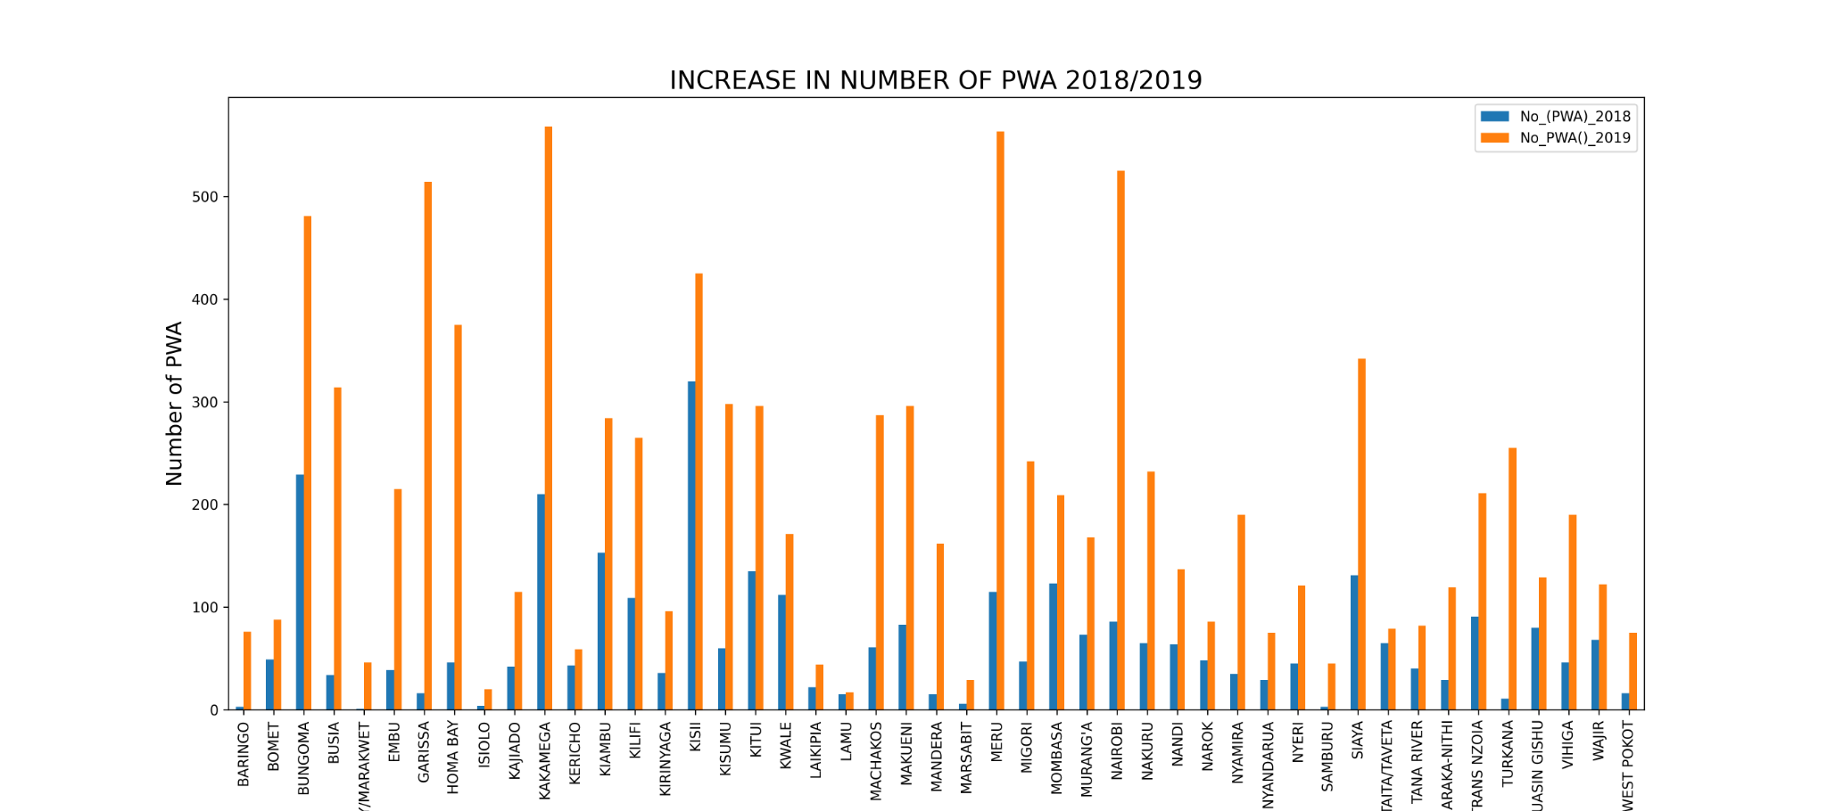

Slide 9
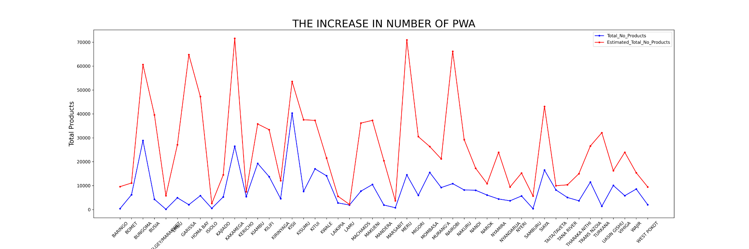

Slide 10
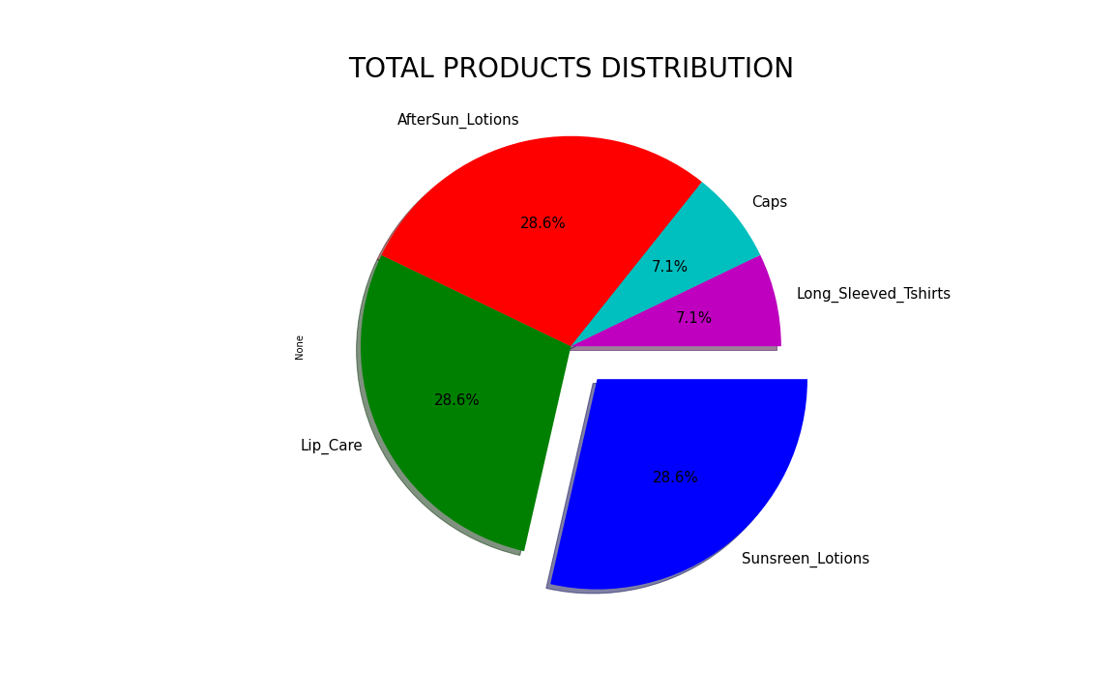

Slide 11
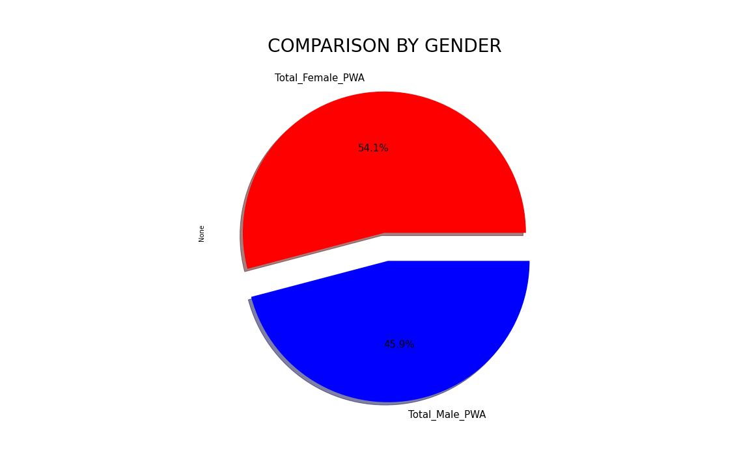

Slide 12
RECOMMENDATIONS
Support epidemiological studies on albinism in order to gather the data necessary to develop public health policies by assisting counties and other stakeholders in ensuring data collection on people with albinism nationally, regionally, and globally, in line with human rights approach and principles.
The government should regularly update their database of people living with albinism to ensure it’s up to date as opposed to relying on estimated data to implement the distribution of sunscreen and other support products.
The government should increase the supply of sunscreen and support products because the number of people with albinism has increased.
The government should distribute more products to those counties that have a higher number of PWA.
The government, particularly the Ministry of Health, should ensure equitable distribution of health facilities for PWA across the country, especially in counties with the least number of health centers such as E. Marakwet, West Pokot and Uasin Gishu.
To enhance health for PWA and prevent early death due to skin cancer. These include:
ensuring that the announced sunscreen program is effective.
supporting initiatives for producing sun protection cream locally.
The government should conduct scientific research to find out why females have the highest number of albinism cases.

Slide 13
EVALUATION
There is consistency in the examined data, and the inference made is that Kenya has taken steps to improve the lives of PWA including the ongoing attempt to expressly capture albinism into its laws on disability, affirmative action and sunscreen plus other support products distribution programs.
Considering the findings of the project and acknowledging the specifics of the research objectives it has been concluded that while Kenya has made some strides to advance the rights of PWA, there remains an extensive array of work to be done.
At the very least being intensive public awareness and sensitization to humanize persons living with this obvious and immutable condition; standardizing reasonable accommodation for them at schools; and ensuring the effectiveness of the sunscreen program and affirmative action programs to ensure that many more are protected and employed indoors

Slide 14
Thank You

